Slide 1

MA2012 INTRODUCTION TO MECHATRONICS SYSTEMS DESIGN
Lecture 1
Prof Ang Wei Tech
College of Engineering
School of Mechanical and Aerospace Engineering

Slide 2
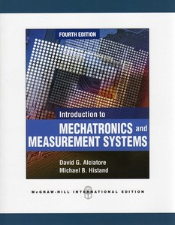

TEXTBOOKS, LECTURE SLIDES AND HANDOUTS
Textbooks
Introduction to Mechatronics and Measurement Systems, 4th Ed., D. G. Alciatore & M. B. Histand, McGraw Hill, 2012
Exploring Arduino, Jeremy Blum, Wiley, 2013
Lecture Slides & Lab Handouts
Will be posted on NTULearn in due course

Slide 3
COURSE OBJECTIVES
To understand and develop mechatronics systems using microcontrollers to interface with various types of input devices, displays and actuators
To gain hands-on experience and knowledge of mechatronics system design and development
To interpret tasks into technical specifications
To read and understand component data sheets

Slide 4
SCOPE
We shall learn sufficient details to understand the components of a mechatronics system and the techniques required to accomplish mechatronic tasks effectively
We shall not learn all the low level details, architecture and manufacturing process of the electronic/electrical components as required by Electrical & Computer engineers

Slide 5
MECHATRONICS
Mecha-nical + Elec-tronics
A term coined in Japan in 1960s
A interdisciplinary field of engineering dealing with the design of products whose function relies on the integration of mechanical and electronics components coordinated by a control architecture

Slide 6
SYSTEM
Definition
A combination of related parts organized into a complex whole
System science
An interdisciplinary field of science that studies the nature of complex systems
System engineering
An interdisciplinary field of engineering that focuses on how complex systems should be designed, engineered and managed

Slide 7
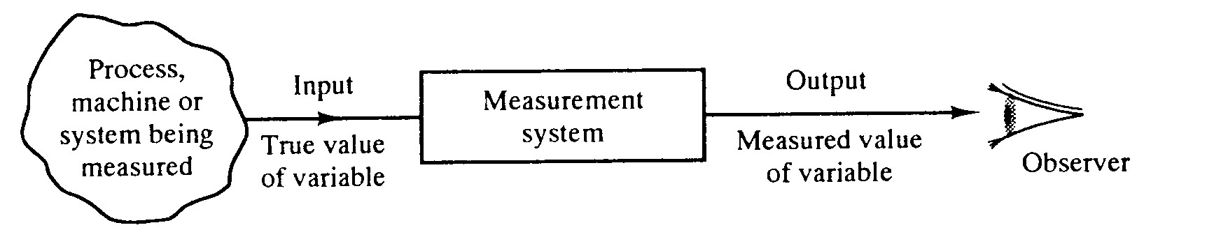
SYSTEM
Measurement system
A system that presents an observer with a numerical value that represents the state or change of a variable of a process, machine or system being measured
Transducer
Signal Processor
Recorder

Slide 8
SYSTEM
Actuation system
A system that converts one form of energy (e.g. electrical, chemical, etc.) to another to perform mechanical work (e.g. movement, heat, etc.).
Input
Actuation System
e.g. Motor
Output
Electrical Power
Rotation

Slide 9
SYSTEM
Control system
A system to modify one or more measurable parameters of a plant or process to achieve desired output(s), E.g. A central heating system
Input: electrical power; Actuation system: heating coil, blower; Plant: environment / room; Measurement system: temperature sensor; Output: desired temperature
Measurement System
Actuation System
Plant / Process
Desired Output
Input
Control System

Slide 10
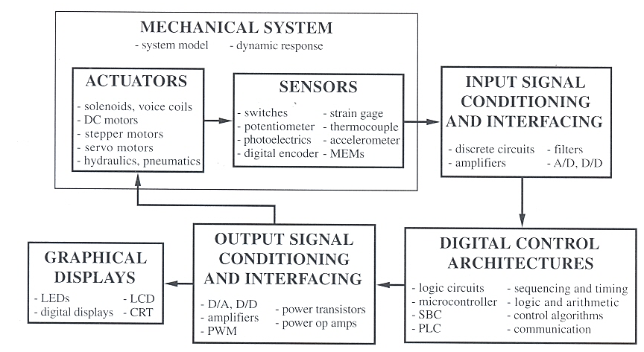
MECHATRONIC SYSTEM COMPONENTS

Slide 11
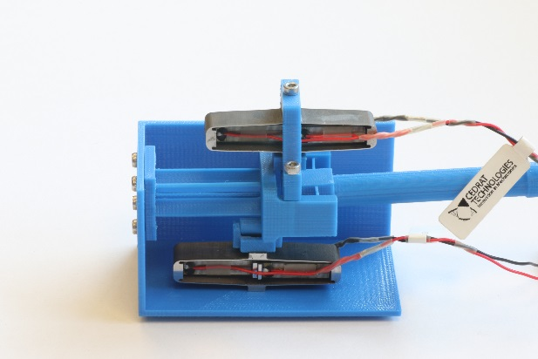
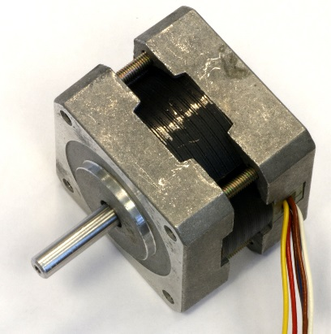
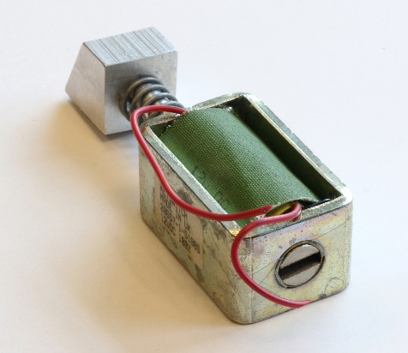
MECHATRONIC SYSTEM COMPONENTS
Mechanical system
Actuators
Motors (AC, DC, Stepper, Servo, Voice Coils, etc.)
Hydraulics, Pneumatics, Solenoids
Piezoelectric, other smart materials
Others: Heating/Cooling elements

Slide 12
MECHATRONIC SYSTEM COMPONENTS
Mechanical system
Sensors
Switches: ON/OFF
Potentiometer, Encoder: Position or displacement
Inertial Sensors:
Accelerometer: Acceleration; Rate Gyroscope: Angular velocity
Thermocouple: Temperature
Strain gage: Deflection
Photoelectrics: Light intensity

Slide 13
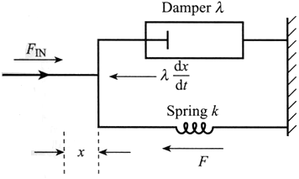
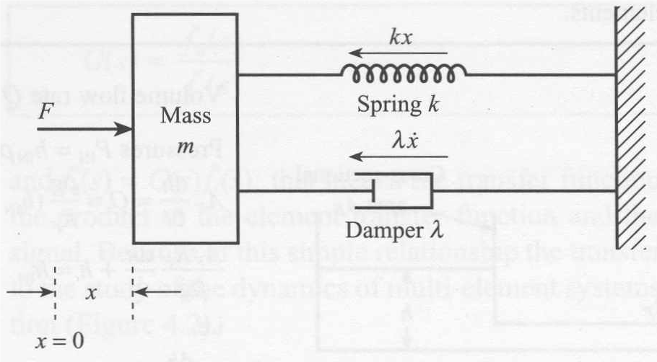
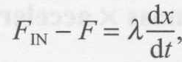
MECHATRONIC SYSTEM COMPONENTS
Mechanical system
System model, e.g. 1st or 2nd order system
1st order
2nd order

Slide 14
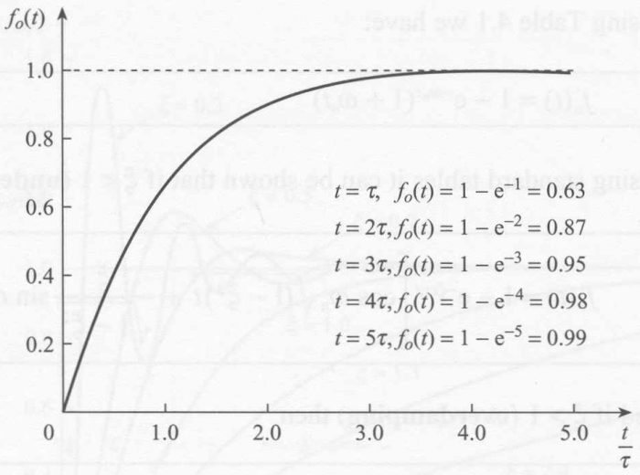
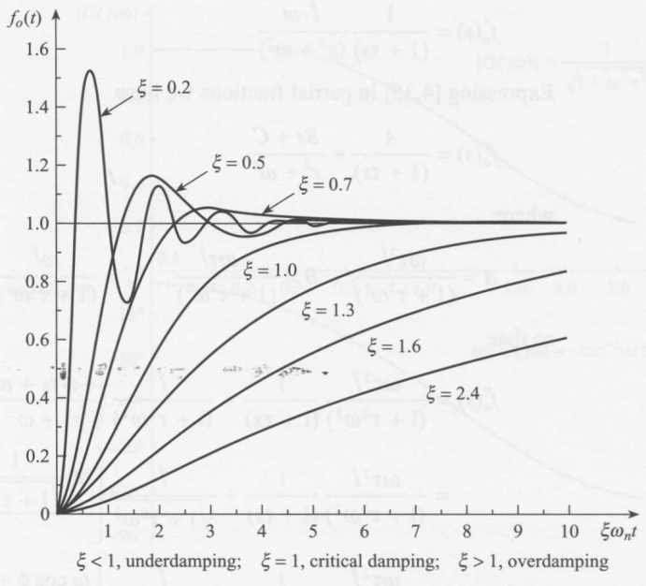

MECHATRONIC SYSTEM COMPONENTS
Mechanical system
1st order
Static & Dynamic responses
Step response
2nd order

Slide 15
MECHATRONICS SYSTEM COMPONENTS
Input signal conditioning and interfacing
Discrete circuits – circuits made up of discrete components (e.g. resistors, capacitors, etc.)
Amplifiers – to amplifier signal to improve signal to noise ratio (SNR)
Filters – to get rid out unwanted signal contents, e.g. highpass, lowpass, bandpass, bandstop, etc.
Analog-to-Digital Converter

Slide 16
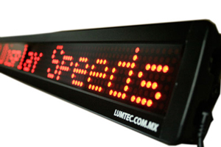
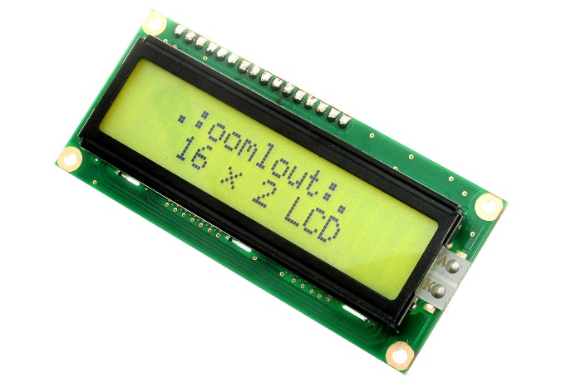
MECHATRONICS SYSTEM COMPONENTS
Output signal conditioning and interfacing
Filters, Op-amps, Digital-Analog Converter (DAC), etc.
GRAPHICAL DISPLAYS
Light Emitting Diodes (LED)
Liquid Crystal Display (LCD)

Slide 17
MECHATRONICS SYSTEM COMPONENTS
Digital control architectures
The ‘brain’ of the system, usually a microcomputer
Microprocessor (MPU) = Central Processing Unit (CPU) on a single integrated-circuit (IC) chip
Microcomputer = MPU + Memory + I/O unit
Microcontroller (MCU) = Microcomputer in a single IC chip
Function: Logic, Arithmetic, Control, Timing & Sequencing, Communications, etc.

Slide 18
EMBEDDED SYSTEMS
Microcontroller for a single purpose (not single function)
Examples
Consumer Products: Mobile Phone, Washer, Fridge, A/C
Healthcare Products: Treadmills, Blood Glucose Metre, etc.
Automobile System Controller & many more
Advantages
Cheap, small, low power consumption
Disadvantages
Inflexible, no or limited expandability

Slide 19
GENERAL PURPOSE COMPUTERS
Examples
PC, Macintosh, Workstation, PDA, Smartphone, etc.
Advantages
Flexibility – capable of running many software and interface with lots of devices
Expandability / Scalability – software & hardware upgradeable
Disadvantages
Complexity – to cater for flexibility & expandability
Cost – $100’s to $1,000’s
Power Consumption – high
Outnumbered by embedded systems >100:1

Slide 20
BASIC COMPUTER STRUCTURE
All computers contain 3 basic units:
Central Processing Unit (CPU)
Arithmetic & Logic Unit (ALU)
Control Unit
Memory Unit
Internal – Random Access Memory (RAM), Read-only Memory (ROM)
External – Hard Disk, Tape, etc.
Input/Output (I/O) Unit
Input Unit – Mouse, K/B, Analog/Digital Converter (ADC)
Output Unit – Display, Digital/Analog Converter (DAC)

Slide 21

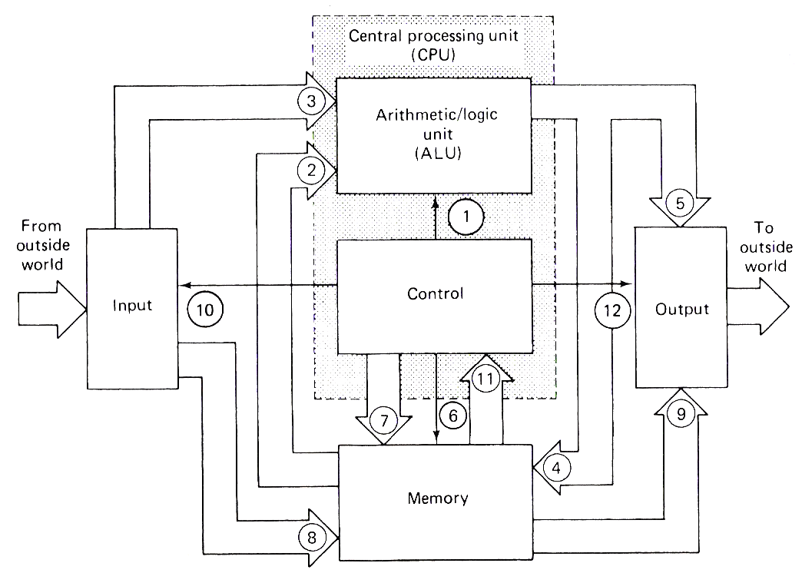
BASIC COMPUTER STRUCTURE
Redo this figure and remove the numbers in the arrows.
Central processing unit
(CPU)
Arithmetic/logic unit
(ALU)
From
outside
world
To
outside
world
Input
Control
Output
Memory

Slide 22
CENTRAL PROCESSING UNIT (CPU)
CPU = ALU + Control unit
Arithmetic and Logic Unit (ALU)
Arithmetic: +, –, x, ÷, etc.
Logic: OR, AND, NOT, NOR, NAND, XOR, etc.
Result of ALU is usually stored in the Accumulator register (More later)
Control Unit
Directs the operation of all parts of computer by providing timing and control signals
Fetches, decodes, and executes the instructions in memory

Slide 23
MEMORY
A memory cell is a device or circuit used to store a single bit (“1” or “0”). E.g. FFs, magnetic core, disk
A memory word is a group of memory cells
Internal memory (a.k.a. main or working memory)
Highest speed memory
Function
Store programs for sequenced execution
Store data for output at required time
Types of memory
RAM, ROM, EEPROM

Slide 24
SOFTWARE
microprogram
Collection of instructions that control the timing and control logic of all components of MPU
Built into the MPU by chipmaker & cannot be modified by programmers
FIRMWARE
Software programmed into the Read-Only Memory (ROM) of a MCU for the execution of functions of a device
Programmed by device manufacturer and cannot be modifier by users
program
Software loaded into the Random Access Memory (RAM) of a GP computer
Programmed by software developer (not necessarily device manufacturer) and cannot be modified by users

Slide 25
MECHATRONIC SYSTEM COMPONENTS

Slide 26
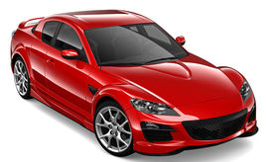

MECHATRONIC SYSTEM EXAMPLE
A typical car contains > 50 MCUs!
Fuel & fluid alert system
Door security system
Air bag system
Seatbelt alert system
Entertainment & Navigation systems
Climate control
Speed control system
ABS braking
Combustion engine control
Automatic gearbox
Active stabilization

Slide 27
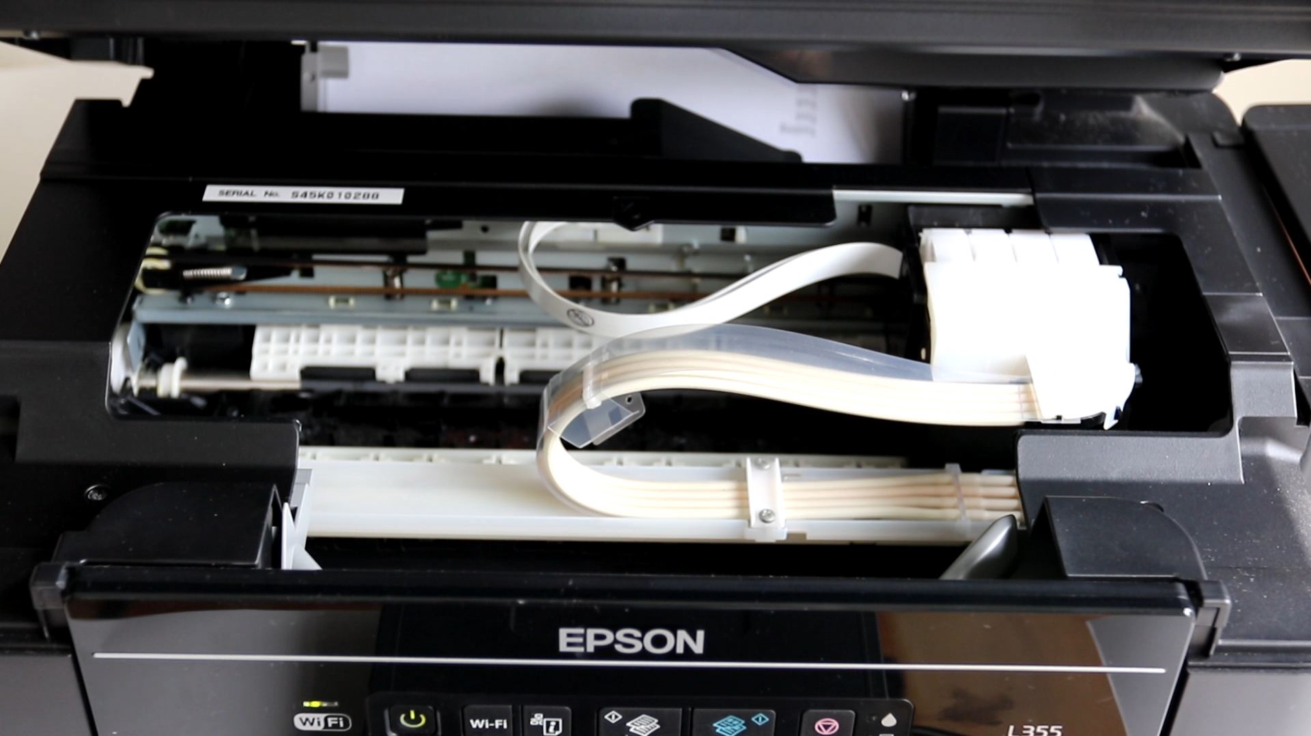
MECHATRONICS SYSTEM EXAMPLE
Inkjet Printer
How many actuators are there? What type?
How many sensors are there in the paper feeding mechanism? In the print head mechanism?
What is the control architecture?

Slide 28
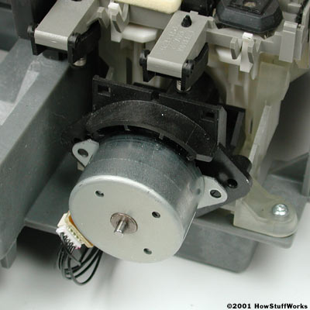
MECHATRONICS SYSTEM EXAMPLE
Inkjet Printer
Actuators:
Stepper motor to drive print head mechanism
Stepper motor to drive paper feeding mechanism
Stepper motor to park print head mechanism (some models)
Ink firing at nozzles
Piezoelectric (Epson) or Thermal resistor (Canon & HP)

Slide 29
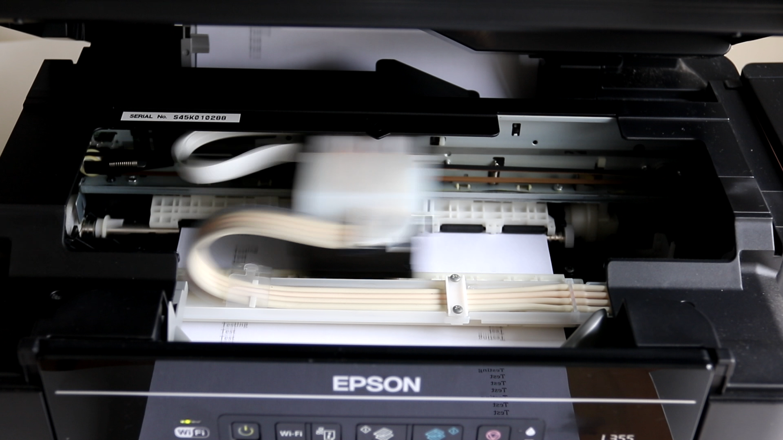
MECHATRONICS SYSTEM EXAMPLE
Inkjet Printer
How many sensors are there in
the paper feeding mechanism?
In the print head mechanism?

Slide 30
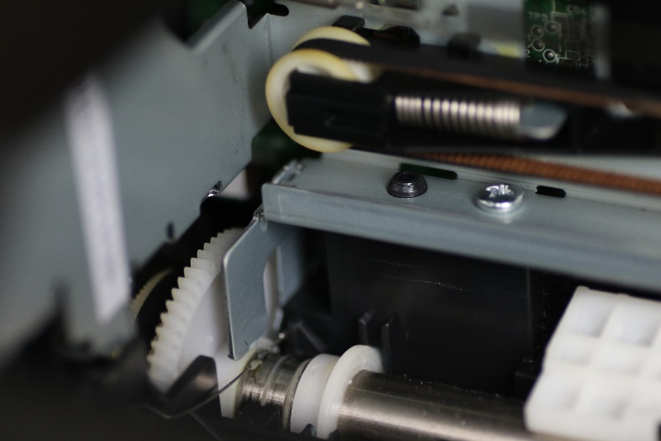
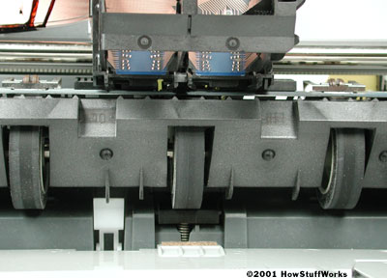
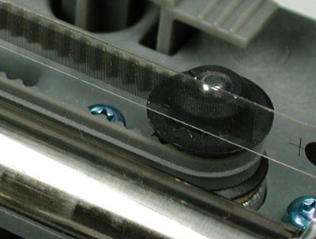
MECHATRONICS SYSTEM EXAMPLE
Inkjet Printer
Sensors in paper feeding mechanism
Proximity sensors or limit switch to detect presence of paper
Proximity sensors to detect paper loaded in position at the start of a print
Sensors in print head mechanism
Linear encoder for precision positioning of print head
Limit switch to detect print head in parked position

Slide 31
MECHATRONICS SYSTEM EXAMPLE
Inkjet Printer
What is the control
architecture?

Slide 32
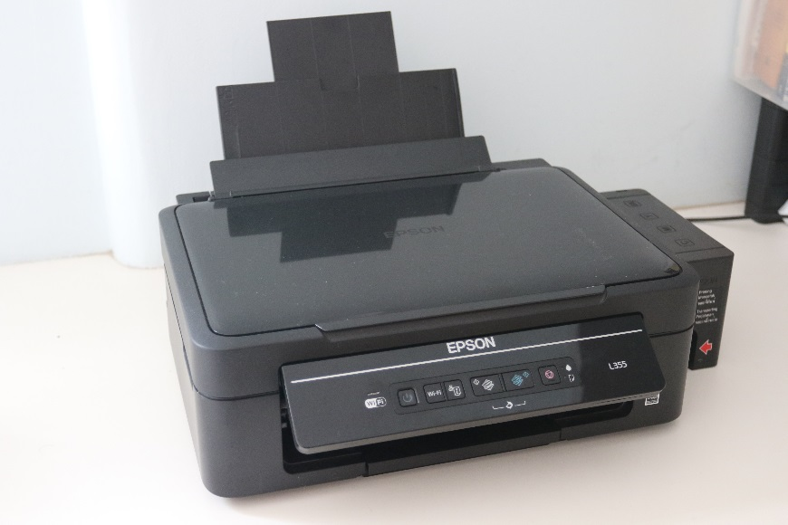
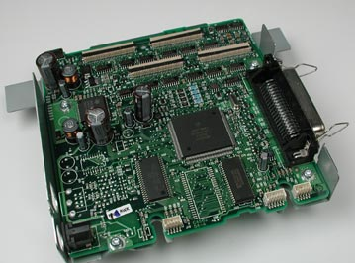
MECHATRONICS SYSTEM EXAMPLE
Inkjet Printer
Digital control architecture
Microcontroller based
Communications:
USB (parallel) port
Bluetooth
LAN port
WiFi
Graphics Display
Simple LCD to high definition LED

Slide 33
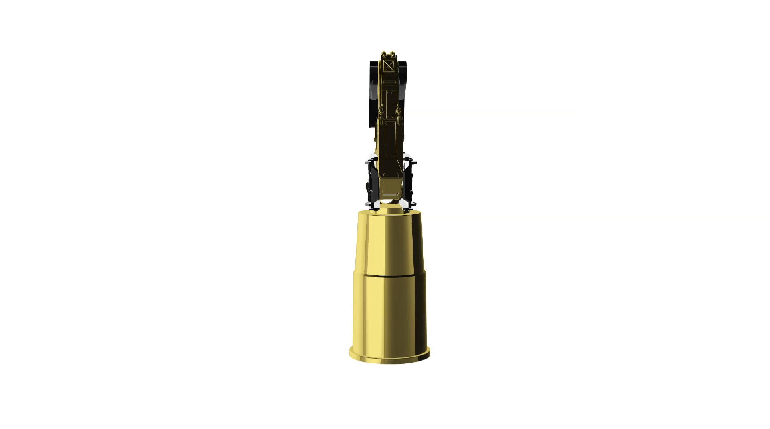
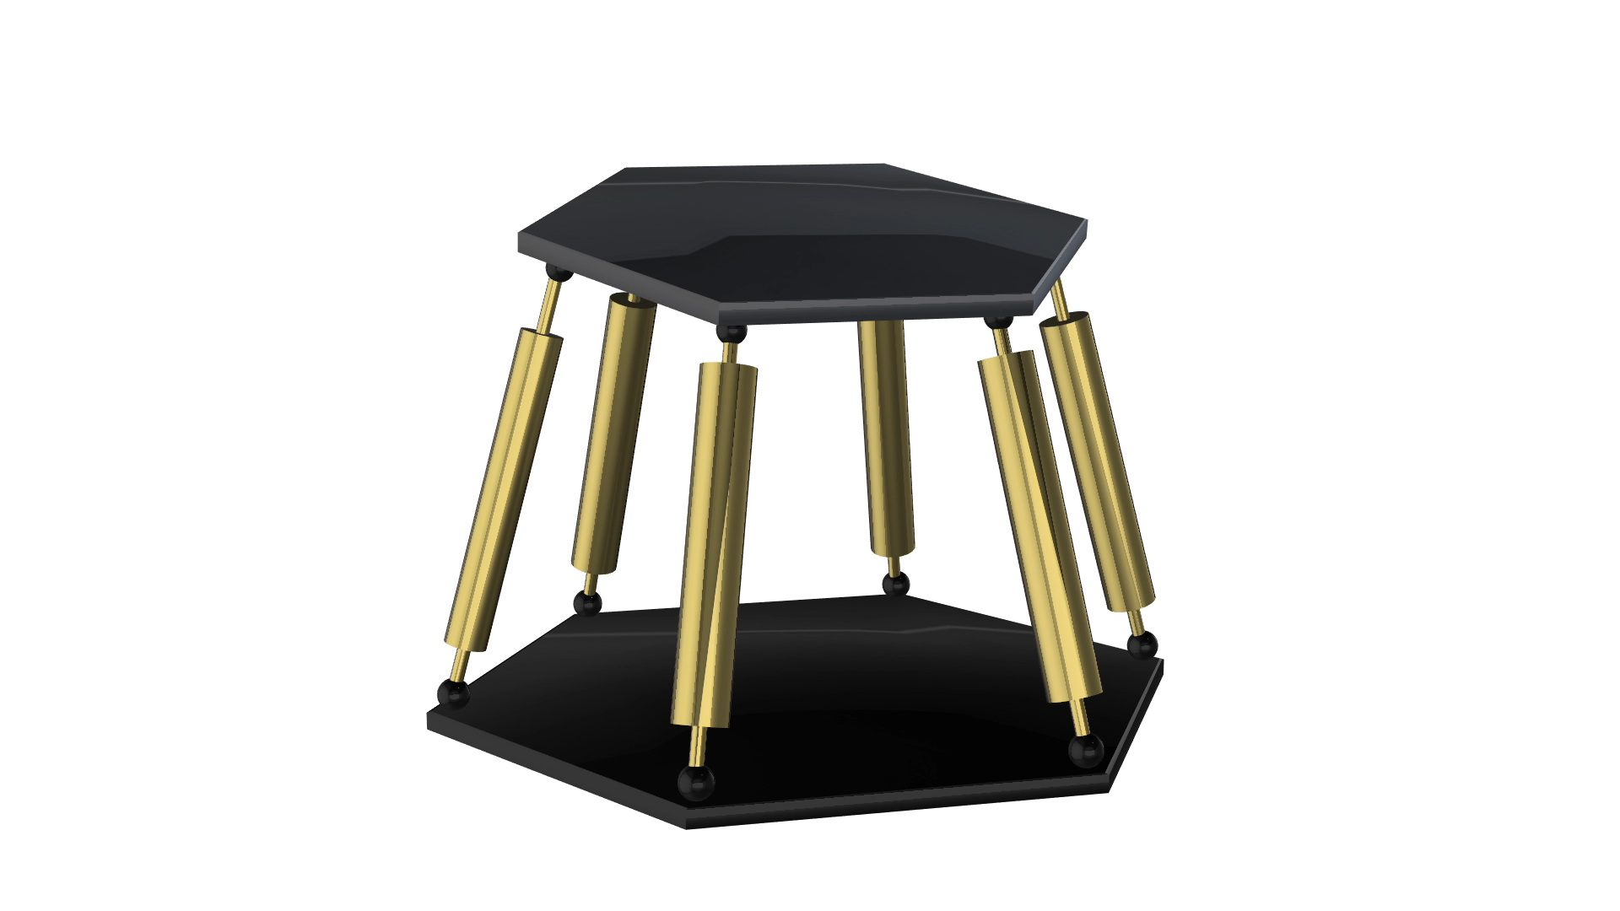
MECHATRONICS SYSTEM EXAMPLE
robot
Serial Robot
Parallel Robot

Slide 34
MECHATRONICS SYSTEMS DESIGN STEPS
To understand the task
To decide on the type of mechatronics component: digital control architecture, actuators, sensors, etc.
To look for the components with the suitable specifications
To ensure compatibility of components: interfacing
To construct hardware prototype
To programme software / firmware

Slide 35
SUMMARY
What is a Mechatronics system?
Systems – definition and example
Mechatronics System Components
Mechatronics System Examples
Mechatronics System Design Steps

Slide 36
ATTRIBUTIONS
By KaiLumtec (Own work) [CC BY-SA 3.0 (http://creativecommons.org/licenses/by-sa/3.0)], via Wikimedia Commons
By oomlout (16x2 LCD Display - LCDD-01) [CC BY-SA 2.0 (http://creativecommons.org/licenses/by-sa/2.0)], via Wikimedia Commons

